Slide 1
Reproductive disorder disease
In simple language this can defined as disease affecting that lead to infertility or sterility
fertility : ability of an animal to reproduce
Infertility : temporary inability of the animal to reproduce
Sterility : permanent inability of the animal to produce
Causes :
1-anatomical (hereditary disease) or structural defector
2-functinal defect(hormonal disease)
3-infection causes
4-management causes

Slide 2
Anatomical or structural defect could be congenital or acquired
Congenital(newborn) anomaly
1- aplasia /absent of ovary
2- hypoplasia of ovary
3- white heifer disease
4- double cervix and external
os
5- agenesis or aplasia of
fallopian tube
6- atresia of vulva
7- hermaphrodite
8- freemartins
Acquired anomaly
1- Overo-bursal adhesion
2- adhesion of uterus
3-prolapse of annular rings
4- fracture of pelvis
5- ovarian tumor
6- vulval tumor

Slide 3
Acquired defect
Ovaro-bursal adhesion: may be due to following:
1- infection causes ex. extension of peritonitis due to traumatic reticulitis into the ovaro-bursal area
2- peritoneal tuberculosis
3- defective manipulation of ovaries like removal of corpus luteum leading to bleeding and adhesions

Slide 4
Acquired defect
Adhesion of uterus :adhesion of uterus to omentum, intestine or to abdominal wall may occur following caesarean operation .
Stenosis of cervix :may as a result of severe cervicitis or due to traumatic injuries . Forceful introduction of AI gun also leads to this.
Fracture of pelvis :this leads to stenosis of the pelvis . This increases the chances of dystocia
Tumors :of the vagina , cervix and uterus causing obstruction

Slide 5
Definition
Teratology: The division of embryology and pathology dealing with abnormal development and malformation of the antenatal(fetal) individual is called teratology .
Anomaly: If the malformation involves only an organ or part of the body, it is called an anomaly.
Monster: If the deformity or malformation is extensive, the animal is called monster.
Intersex: An individual having some of the characteristics of both the sexes and therefore showing abnormalities of sexual development, is called intersex

Slide 6
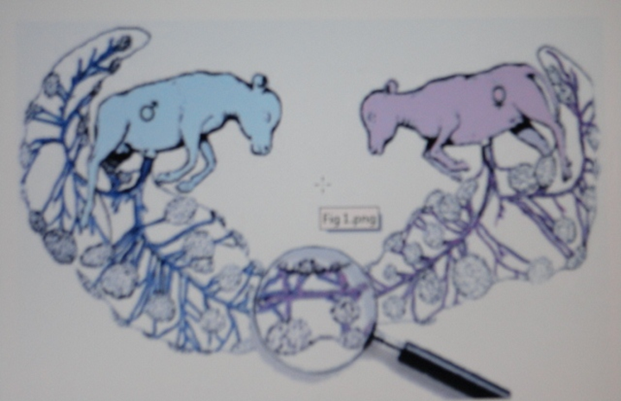
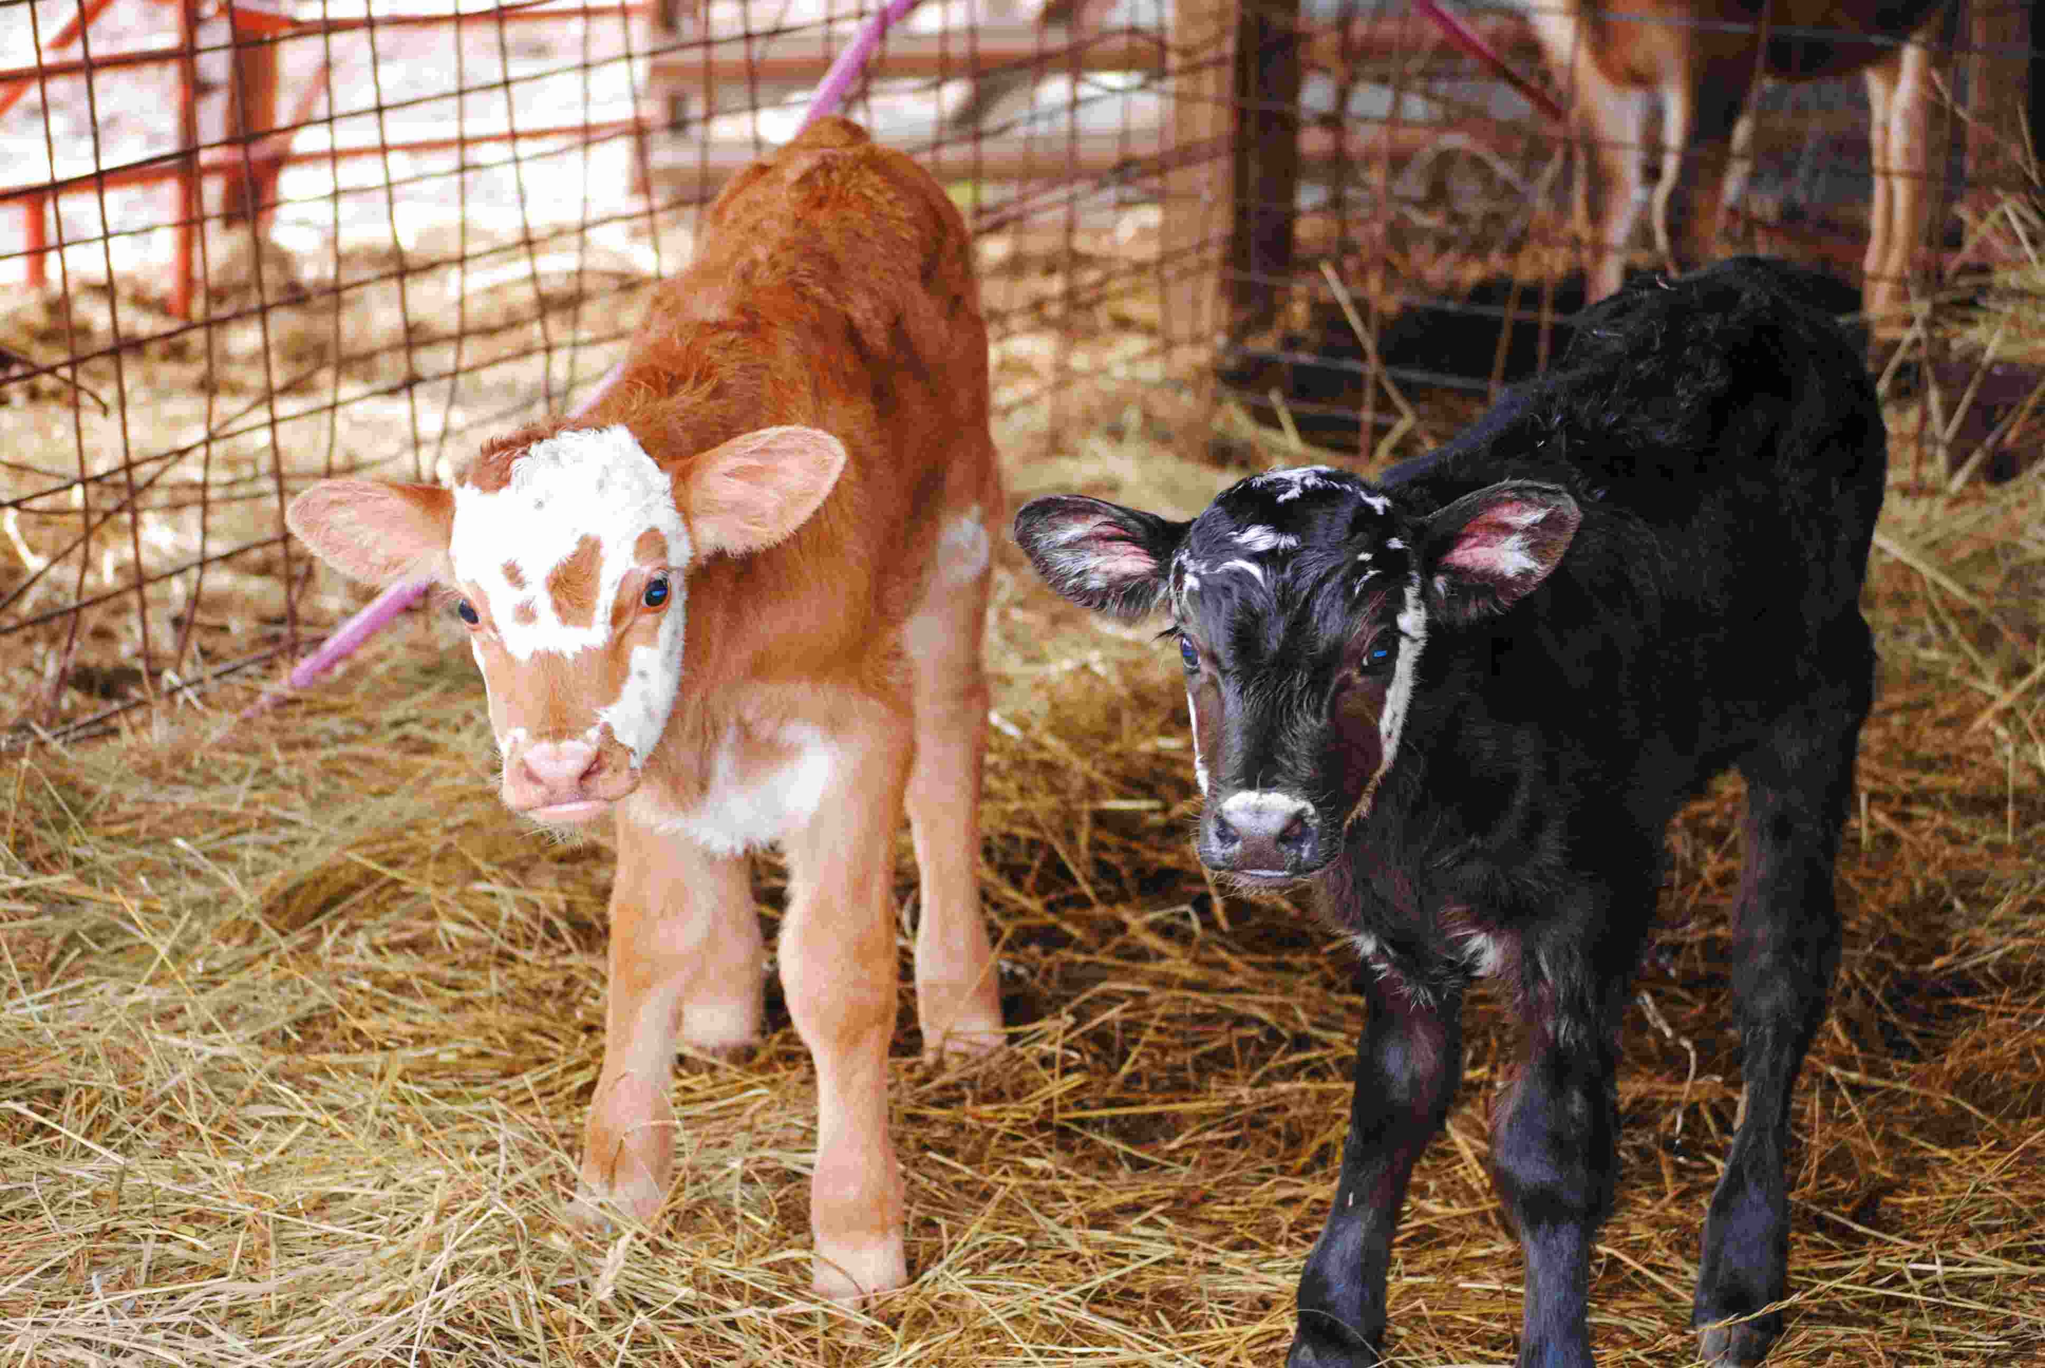
Bovine freemartin : a sterile female calf , born co-twin with a male fetus that shows underdevelopment or misdevelopment genital tract as a result of early development of vascular anastomoses between fetuses of different gender. In cattle this condition is observed in 95% of twin pregnancies

Slide 7
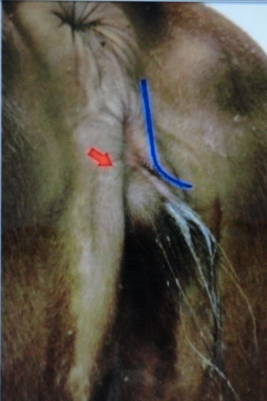
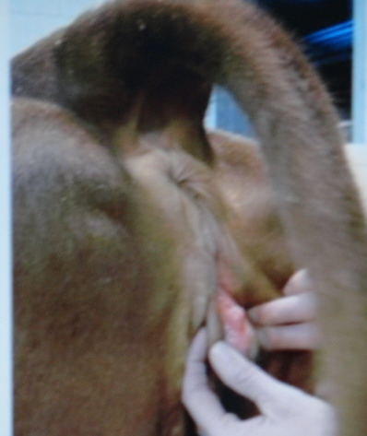
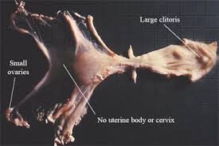
Causes :Placental anastomoses that occur in the early embryonic life are responsible for freemartinism; their presence in females results in masculinisation
Clinical signs :
1-the vulva is smaller and present tuft of hair
2- enlarged clitoris is a common finding and complete hymen
3- vagina is shorter than in normal development
4-the uterus rudimentary or cord like and small ovary
5- presence of seminal vesicle

Slide 8
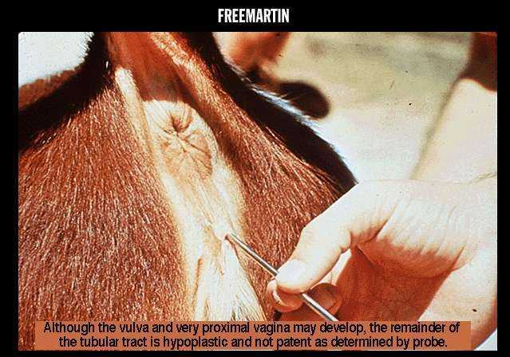
Diagnosis freemartin
1- vagina is shorter(5-7cm) than in normal development(12-15cm)
2- molecular and cytogenetic analysis

Slide 9
hermaphrodite
True hermaphrodite: An individual having both testis and ovary or ovotestes, is called true hermaphrodite.
Pseudohermaphrodite: An individual having gonads of only one sex (either ovary or testis) but external genitalia and secondary characters of opposite sex
Male pseudohermaphrodite: An individual having testes but phenotypically resembles to female, is called male pseudohermaphrodite
Female pseudohermaphrodite: An individual having ovaries but phenotypically resembles to male, is called female pseudohermaphrodite.

Slide 10
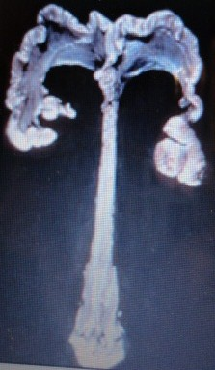
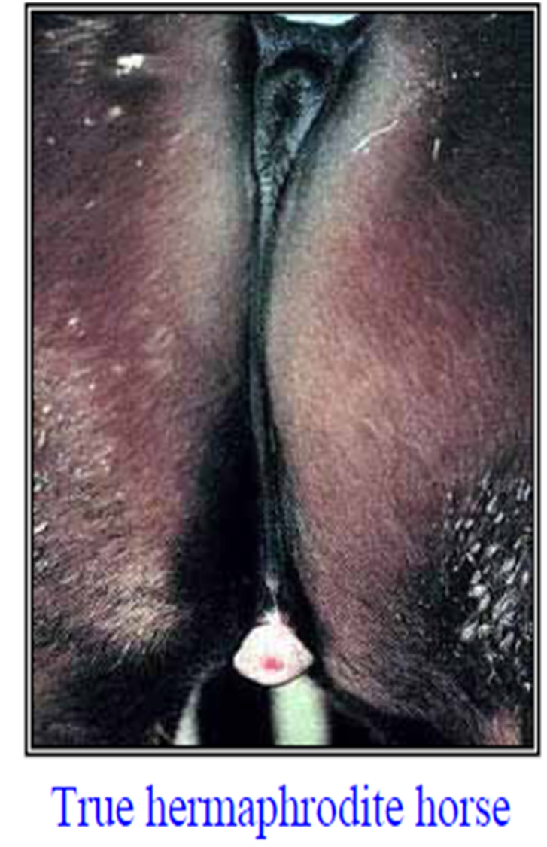
True hermaphrodite

Slide 11
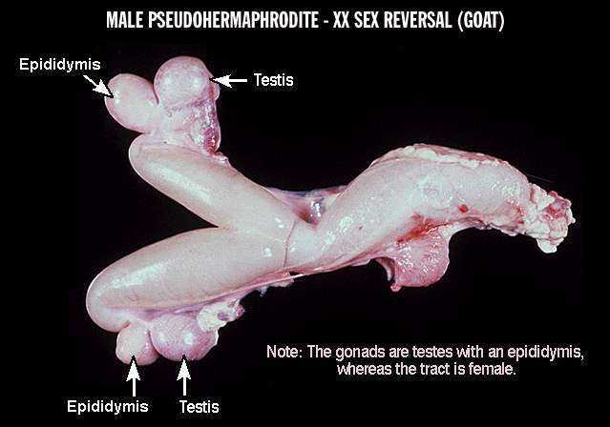
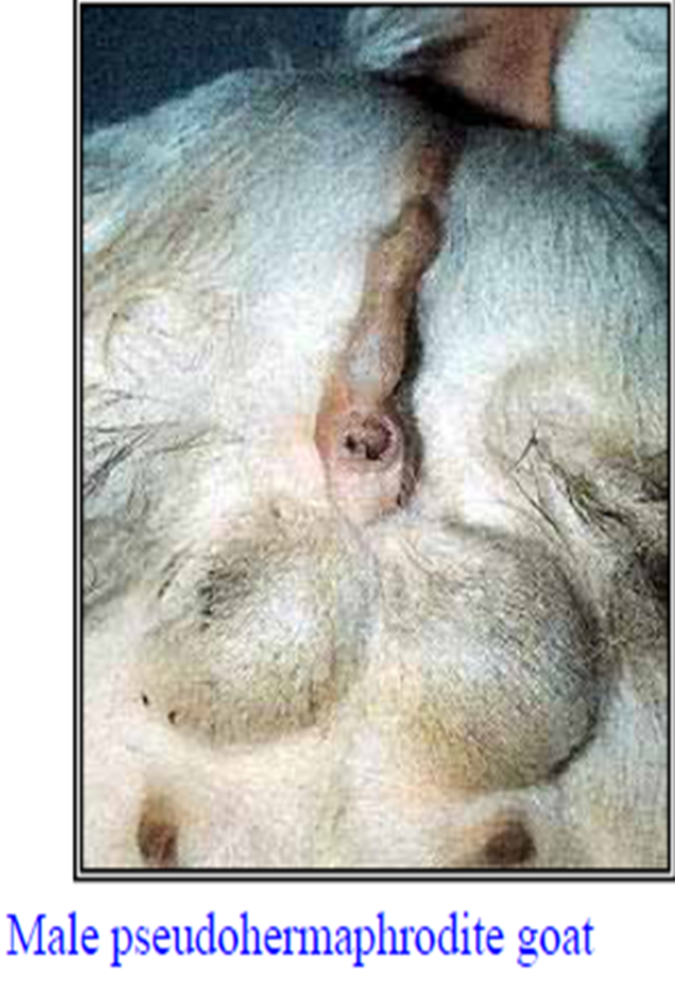
Male pseudohermaphrodite

Slide 12
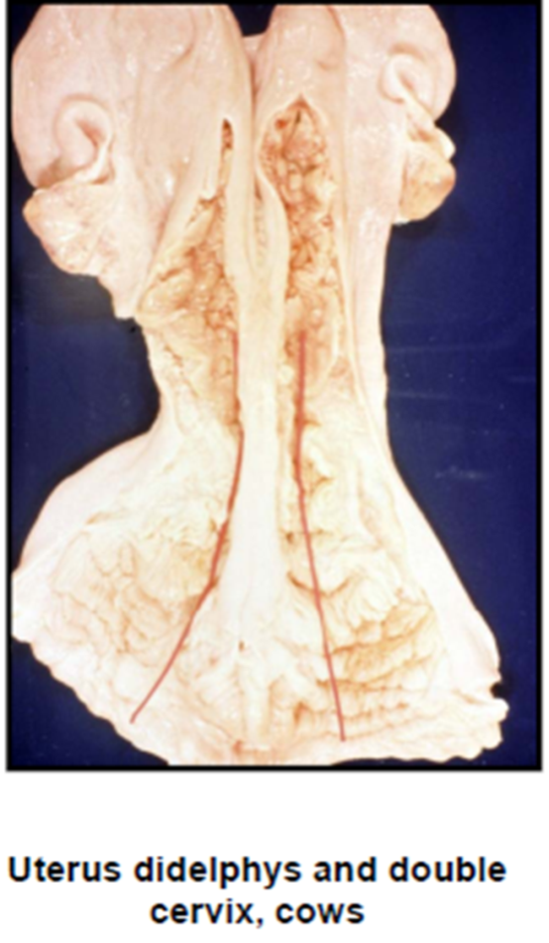
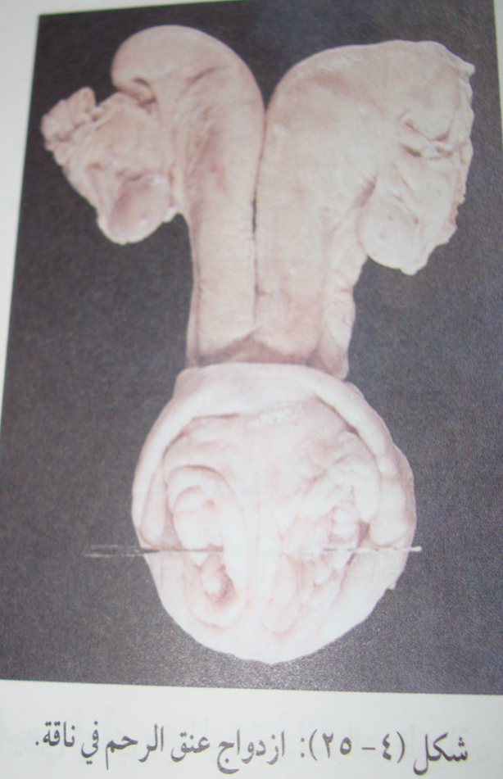
Segmental aplasia of the mullerian duct
Uterus didelphys and double cervix in cow
Double cervix in cow

Slide 13
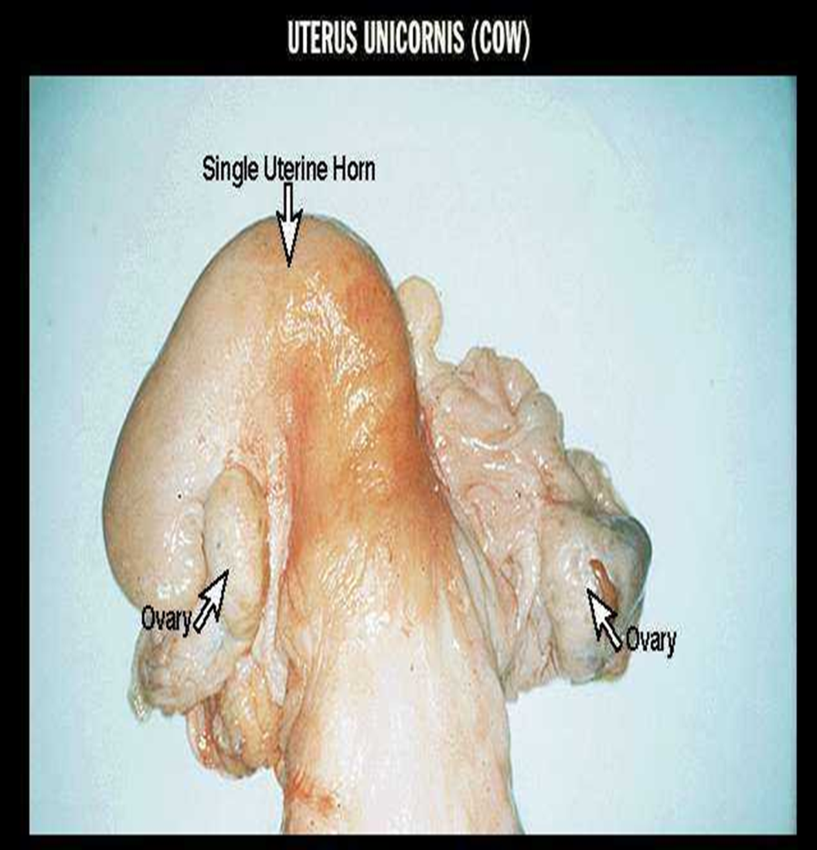
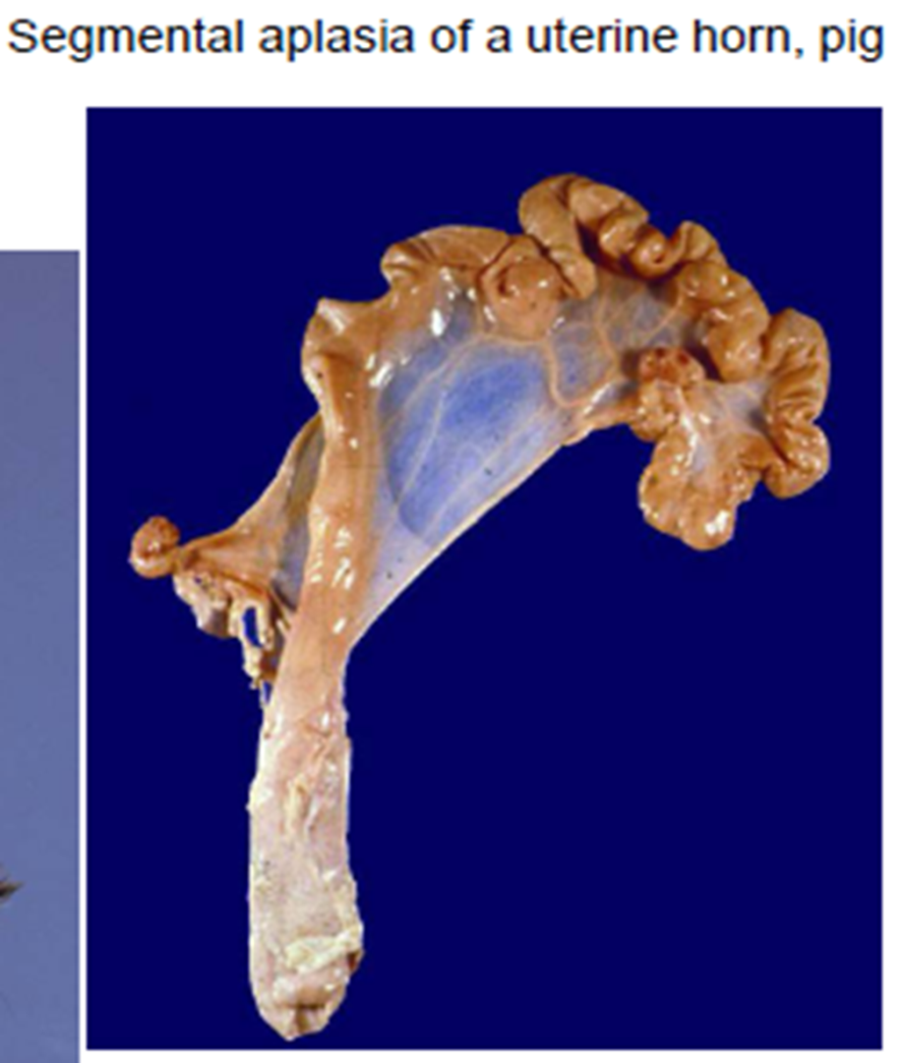
Segmental aplasia of the mullerian duct
Uterus uncorns in cow
Uterus uncorns in sow

Slide 14
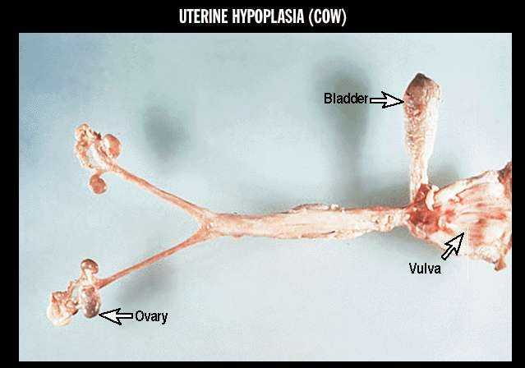

Slide 15
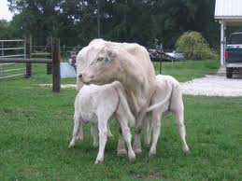
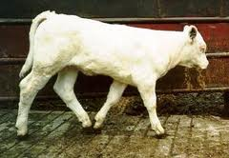
Segmental aplasia of the mullerian duct
White heifer disease: Due to arrested development of the Mullerian duct system, the uterus and the vagina are incompletely developed and development of hymen membrane but the ovaries and vulva are always normal. This abnormality in heifer is called white heifer disease. Because found in white shorthorn breed

Slide 16
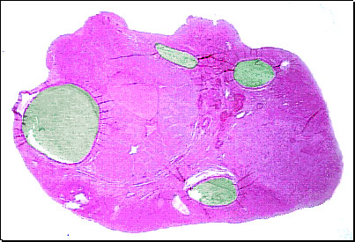
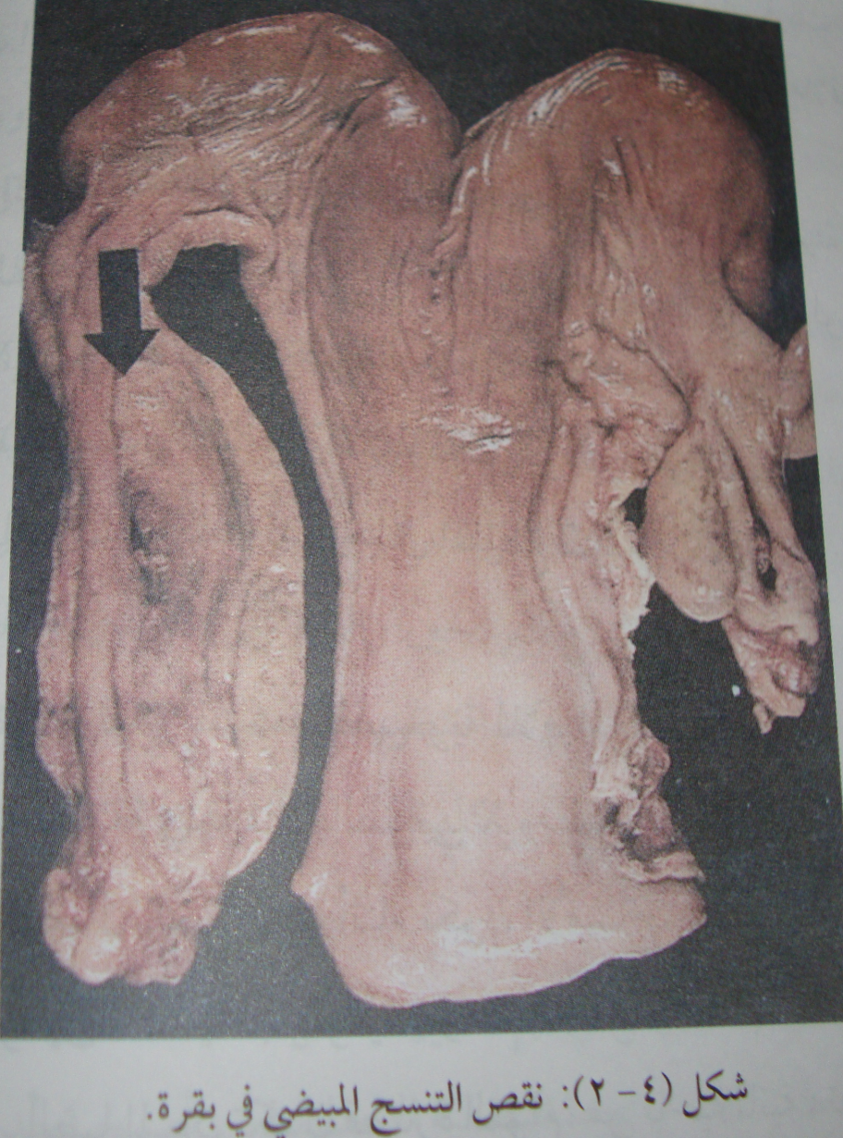
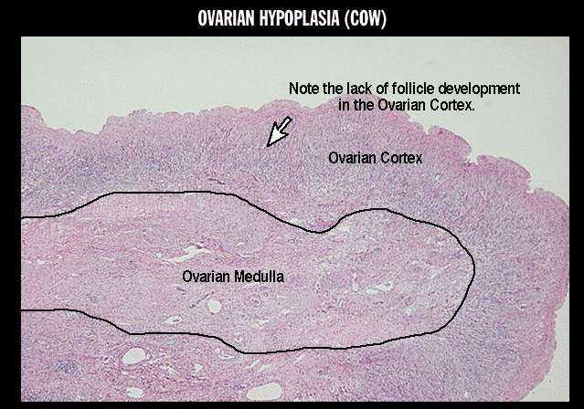
Ovarian hypoplasia
Ovarian hypoplasia in cow
Different between normal and abnormal ovary histology

Slide 17
Ovarian hypoplasia inactive ovaries
1- hereditary causes
2- the case either heifer or cow
3- either bilateral or unilateral
ovary effect
4- the surface of ovary groove
5- the reproductive system
infantile
6- clinical signs of case anestrous
7- no respond to treatment with folligon
1- decrease FSH hormone
2 – the case mostly cow
3- always bilateral ovary effected
4- the surface of ovary smooth
5- the reproductive system normal
6- clinical signs of case anestrous
7 – respond to treatment by folligon

Slide 18
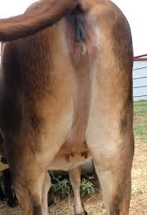
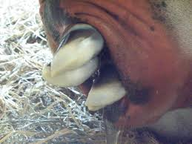
Atresia of vulva
The vulva of heifer is small so causes dystocia so must treatment by episitotomy

